Slide 1
Paper
8 Pieces of Tape
1
Cable with derubberized ends
Sample Fiber
Silver Epoxy

Slide 2
Description of Sample
2

Slide 3
Description of Sample
3

Slide 4
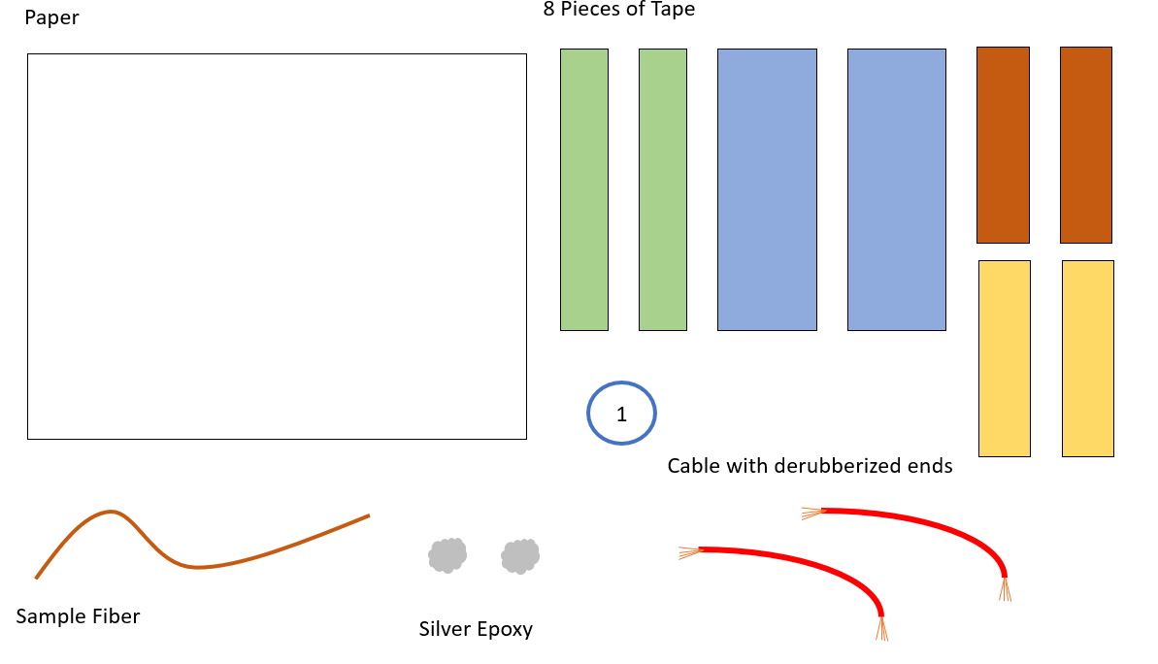
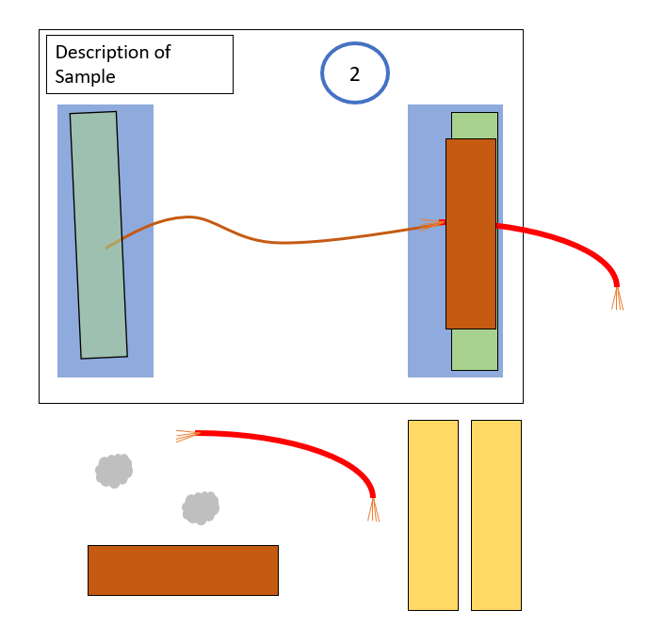
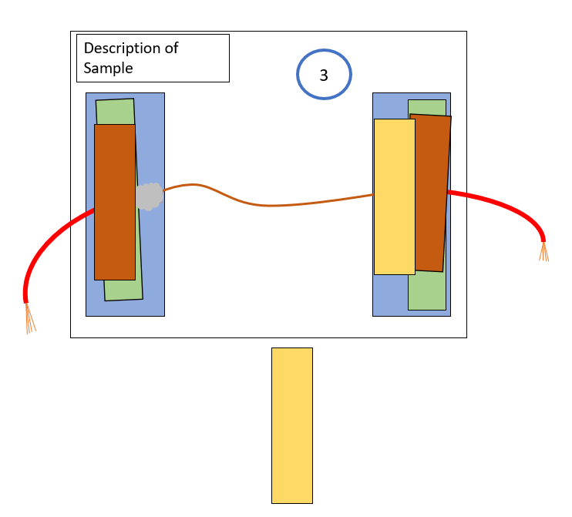
1

